Slide 1
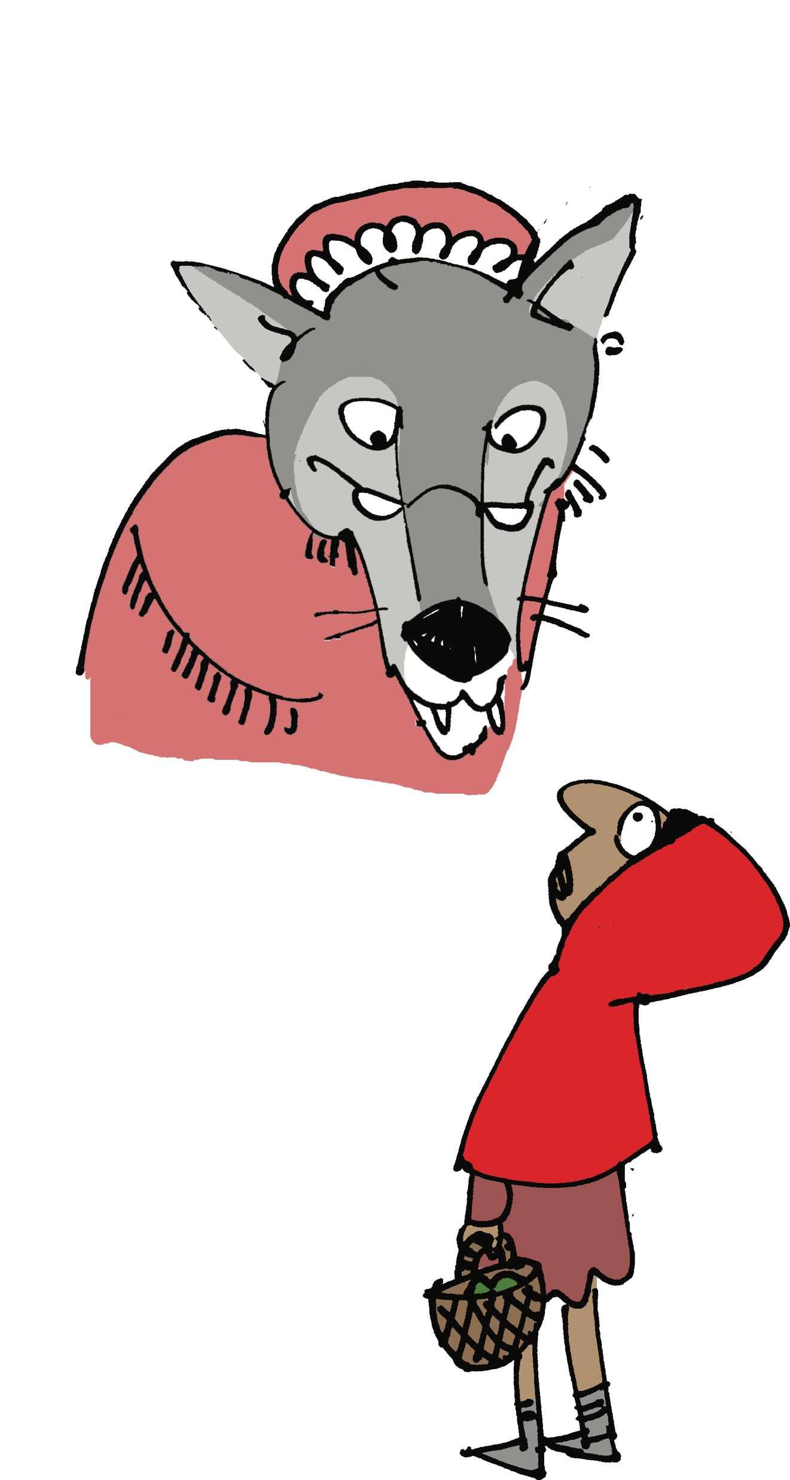



Slide 2



Slide 3


Slide 7


Rule 1: Line 1 must name the character.
Rule 2: Lines 1, 2 and 3 must all contain facts and/or descriptions.
Rule 3: Lines 1 and 2 must rhyme.
Rule 4: Line 4 should tie the story up.
Rule 5: No more rules – there are no rules about rhythm!

